Slide 1

Course Id :INT 213

Slide 2
Tuples
Tuples are like lists, but differ in two ways:
(a) A tuple is a sequence of immutable objects
(you cannot change the value of a tuple)
(b) Tuple use parentheses to define its elements
Once a tuple is created, you cannot add new elements, delete elements, replace elements, or reorder the elements in the tuple.

Slide 3
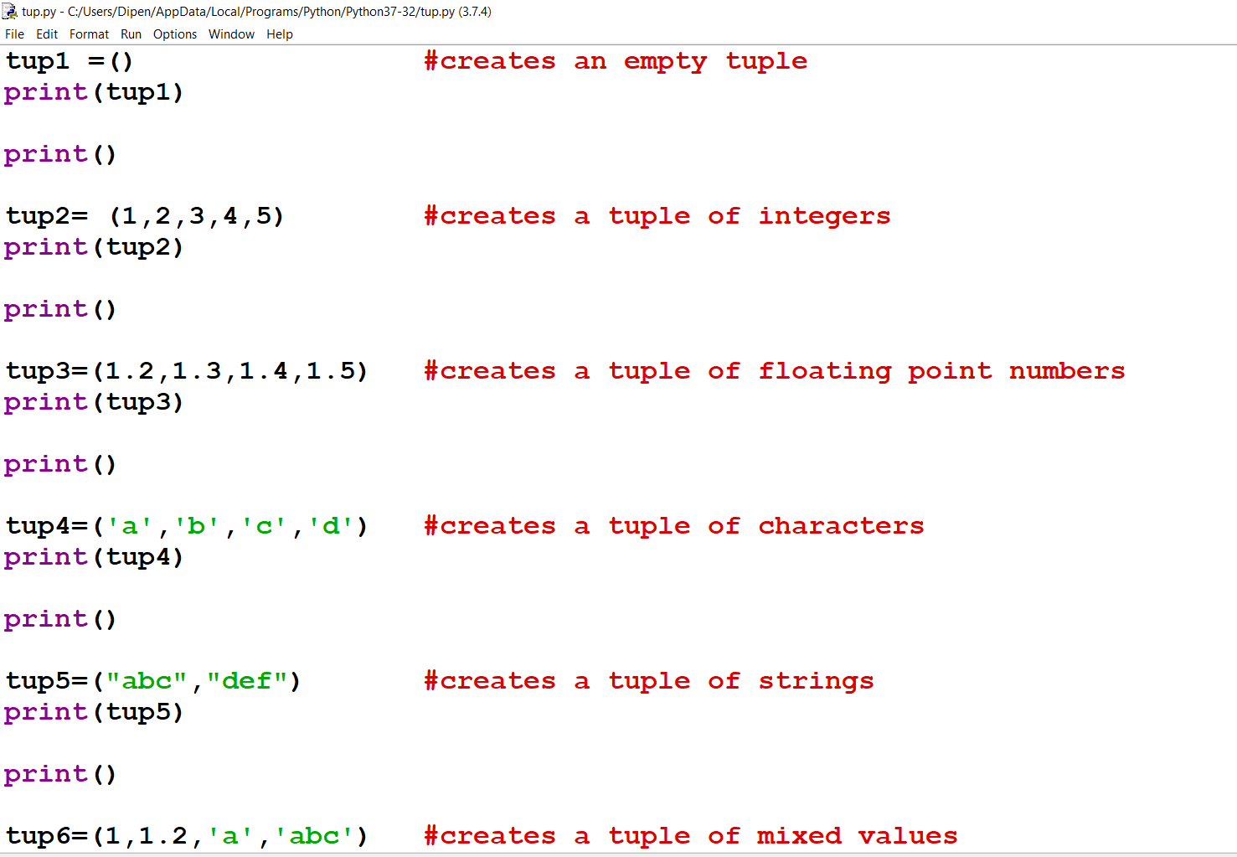
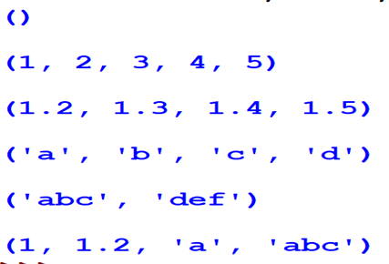
Creating a tuple

Slide 4
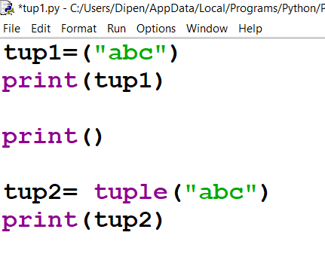
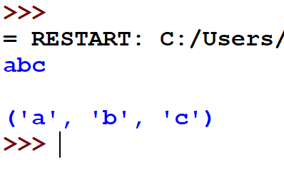
Creating a tuple of strings

Slide 5
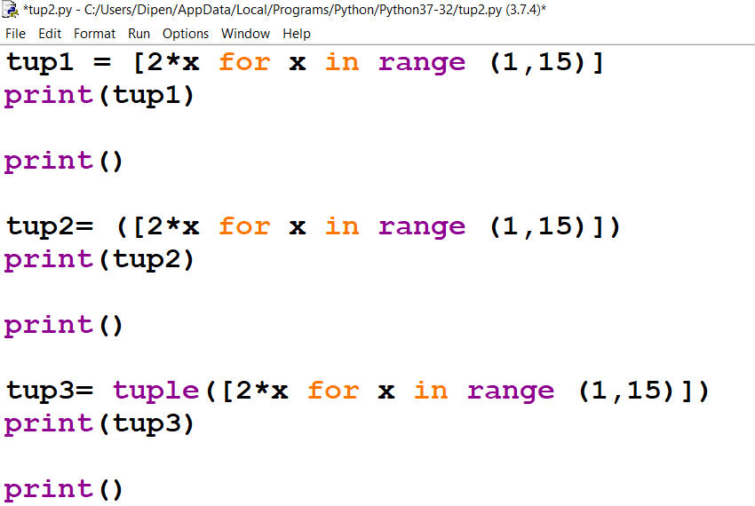
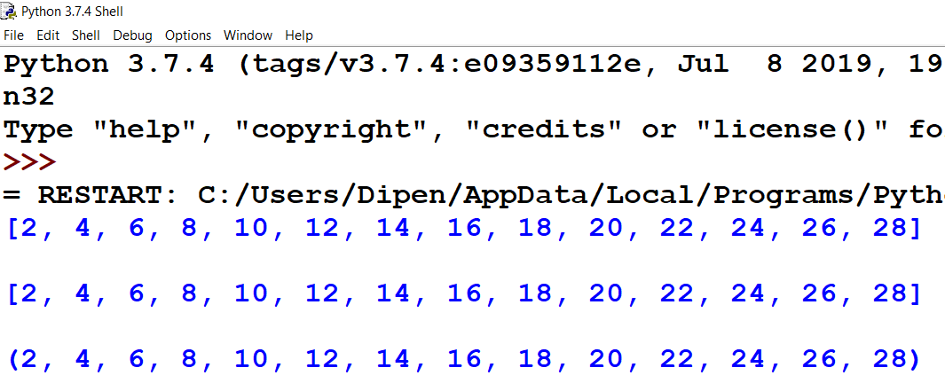
Creating a tuple from a list

Slide 6
Accessing values in a tuple
Indices in tuples also start at 0.
To access a value in tuple, slice operation is used along with the index or indices to obtain the value stored at that index.

Slide 7
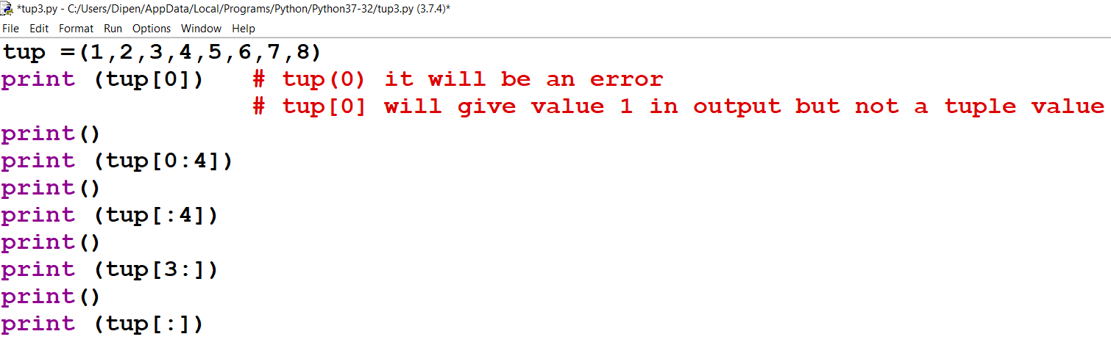
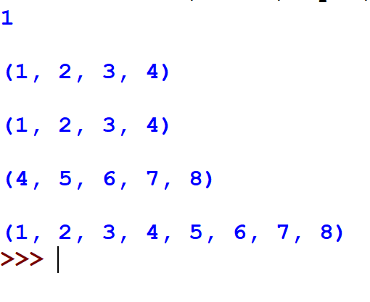
Accessing values in a tuple

Slide 8
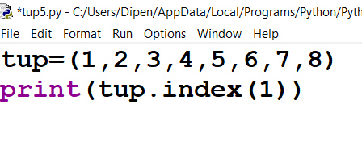
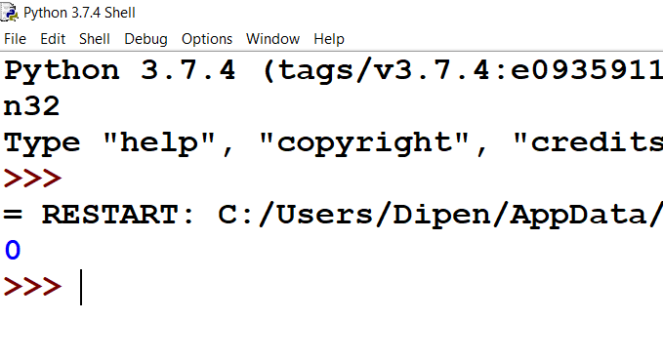
Checking the indexing using index() method

Slide 9
Updating Tuple
Tuple is immutable.
The values in the tuple cannot be changed .
You can only extract values from a tuple to form another tuple.

Slide 10
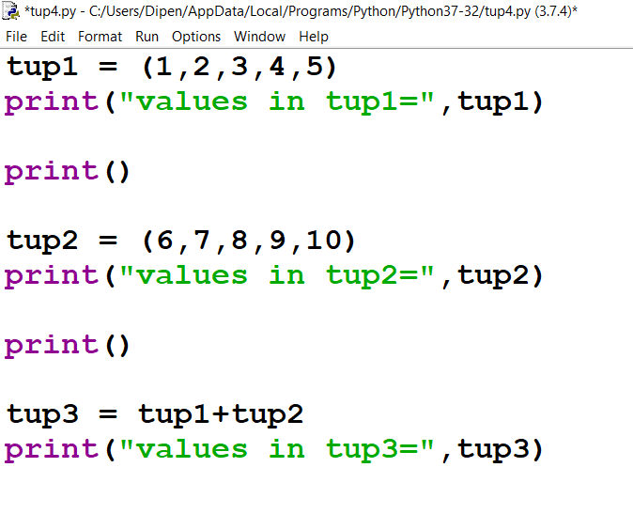
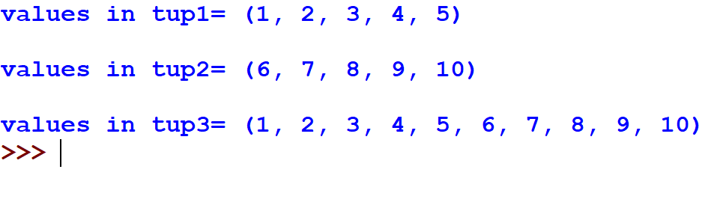
Updating Tuple

Slide 11
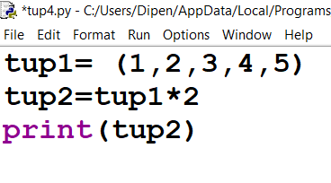
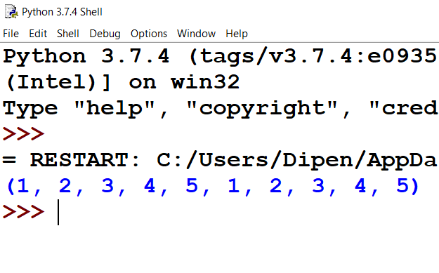
Duplicating a tuple

Slide 12
Deleting an element in a tuple /
Deleting the entire tuple
You cannot delete value/values from a tuple.
You can create a new tuple that has elements in your tuple except the ones you don’t want.
You can always delete the entire tuple.

Slide 13
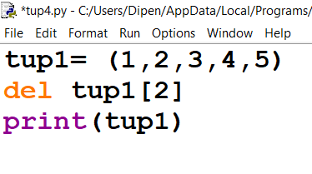
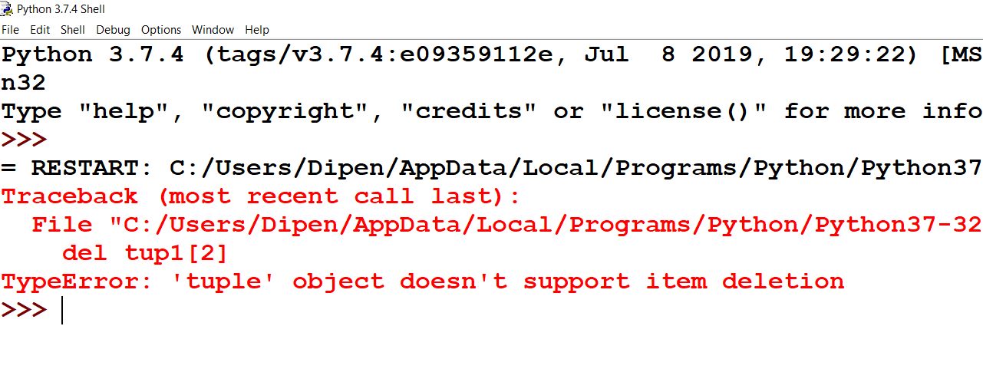
Deleting an element

Slide 14
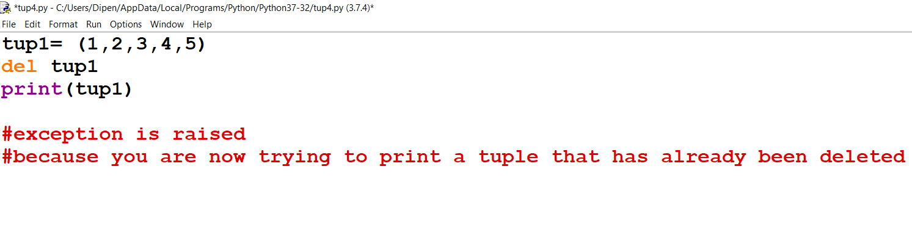
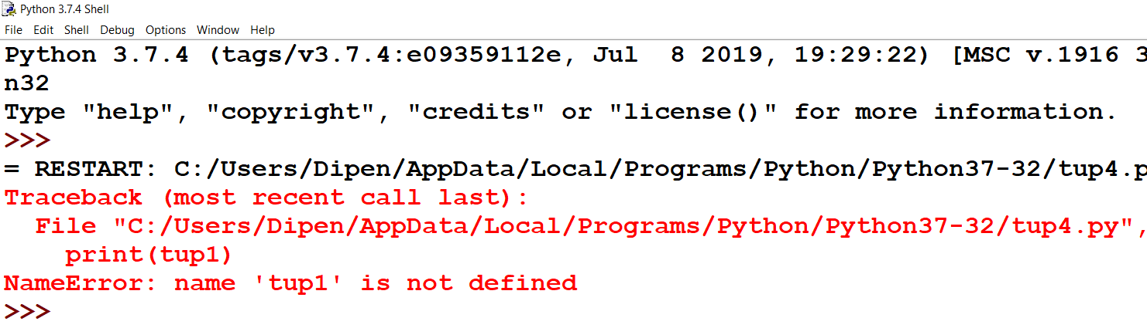
Deleting the entire tuple

Slide 15
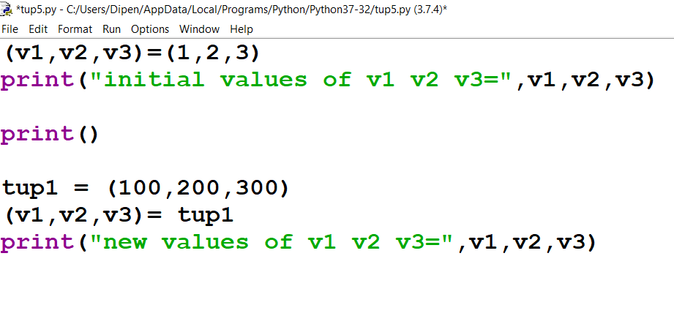
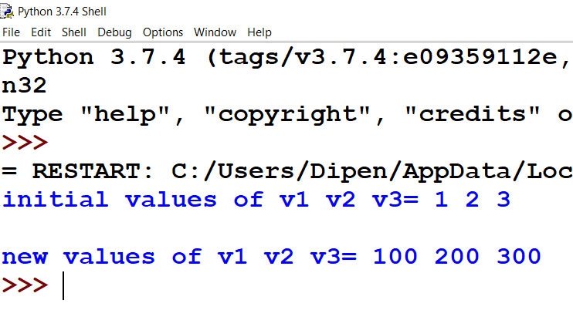
Tuple Assignment

Slide 16
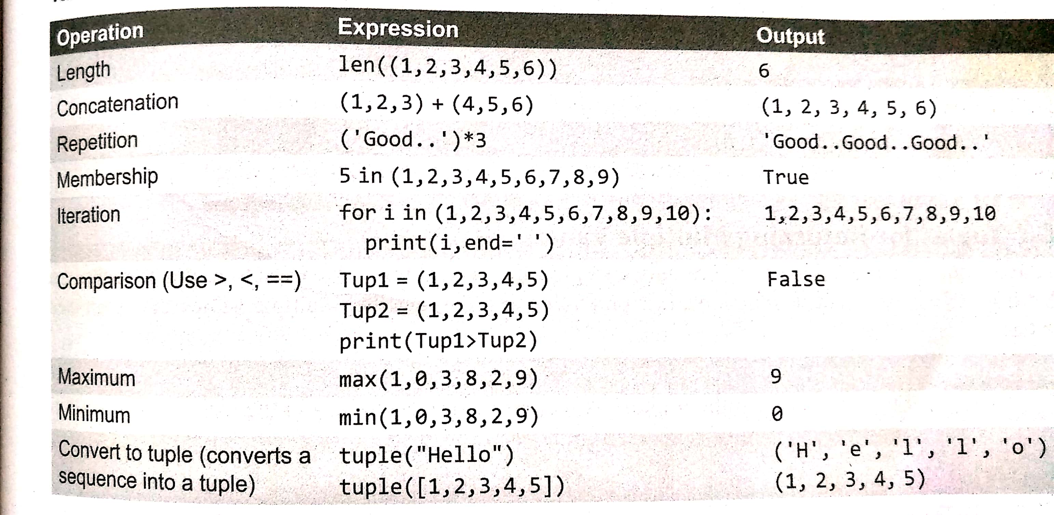
Basic Tuple Operations

Slide 17
Operations Tuples do not support:
remove()
pop()
append()
sort()
reverse()
insert()

Slide 18
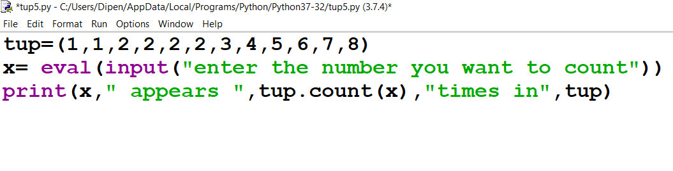
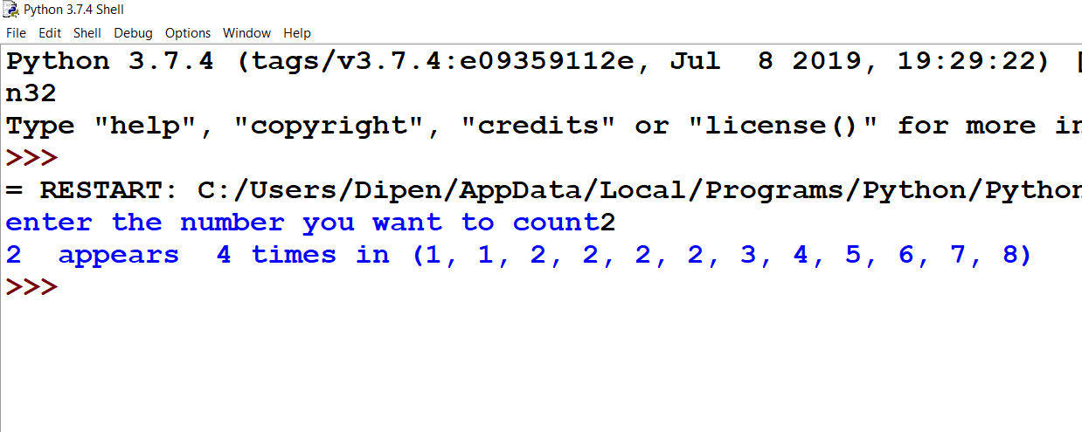
Counting the elements using count() method

Slide 19
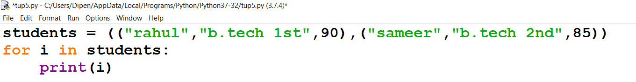
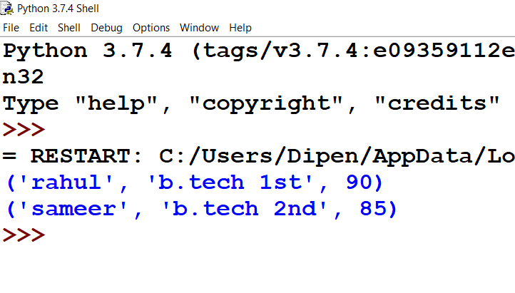
Nested Tuples

Slide 20
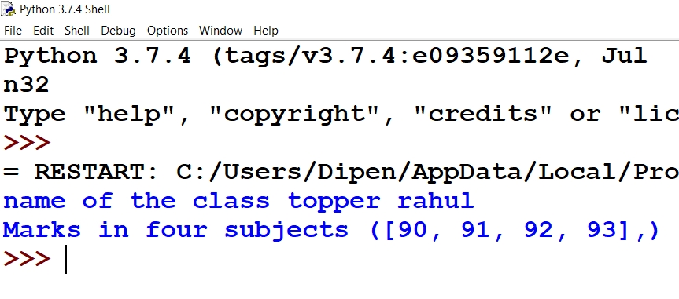
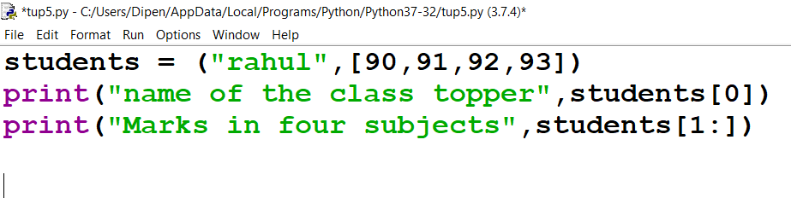
List within a Tuple

Slide 21
zip() function
Zip() is an inbuilt function that takes two or more sequences and zips them into a list of tuples.
T= (1,2,3,4,5)
L= [“a”,”b”,”c”,”d”,”e”]
print(list(zip(T,L)))

